Slide 1
Introduction to R Workshop
Amrom Obstfeld
Association for Pathology Informatics
July 16, 2020

Slide 2
Course Introduction

Slide 3
Goals and Objectives
Advocate for the use of R as a means of improving reproducibility in clinical data analysis
Demonstrate how R is used to perform analyses of laboratory operational data
Establish a basis of understanding in the 'tidy' approach to data analysis within the framework of R

Slide 4
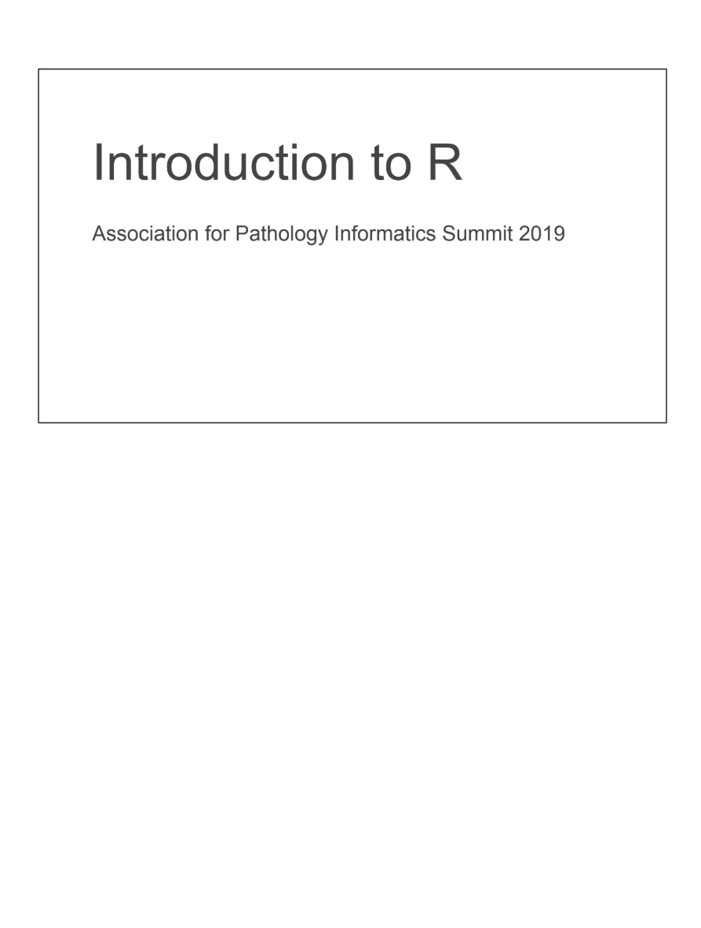
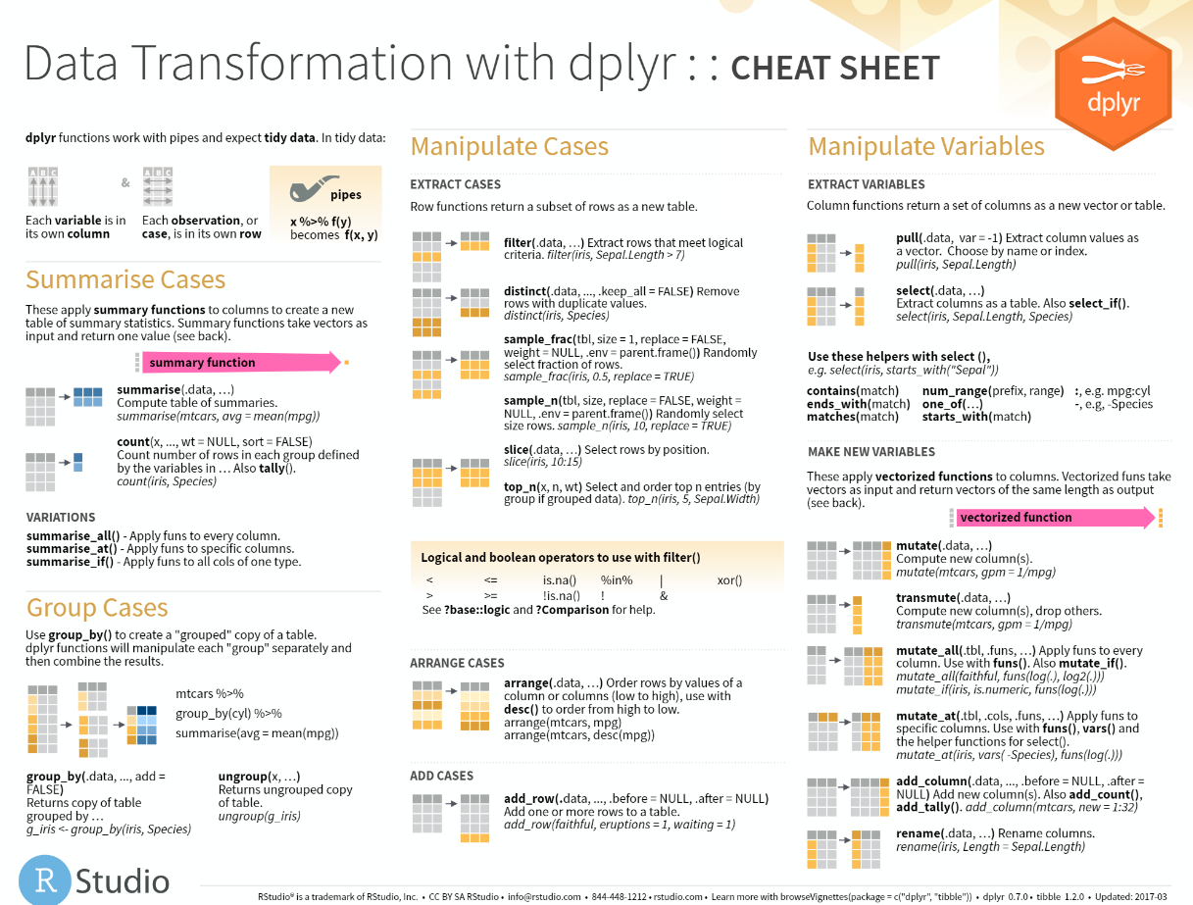
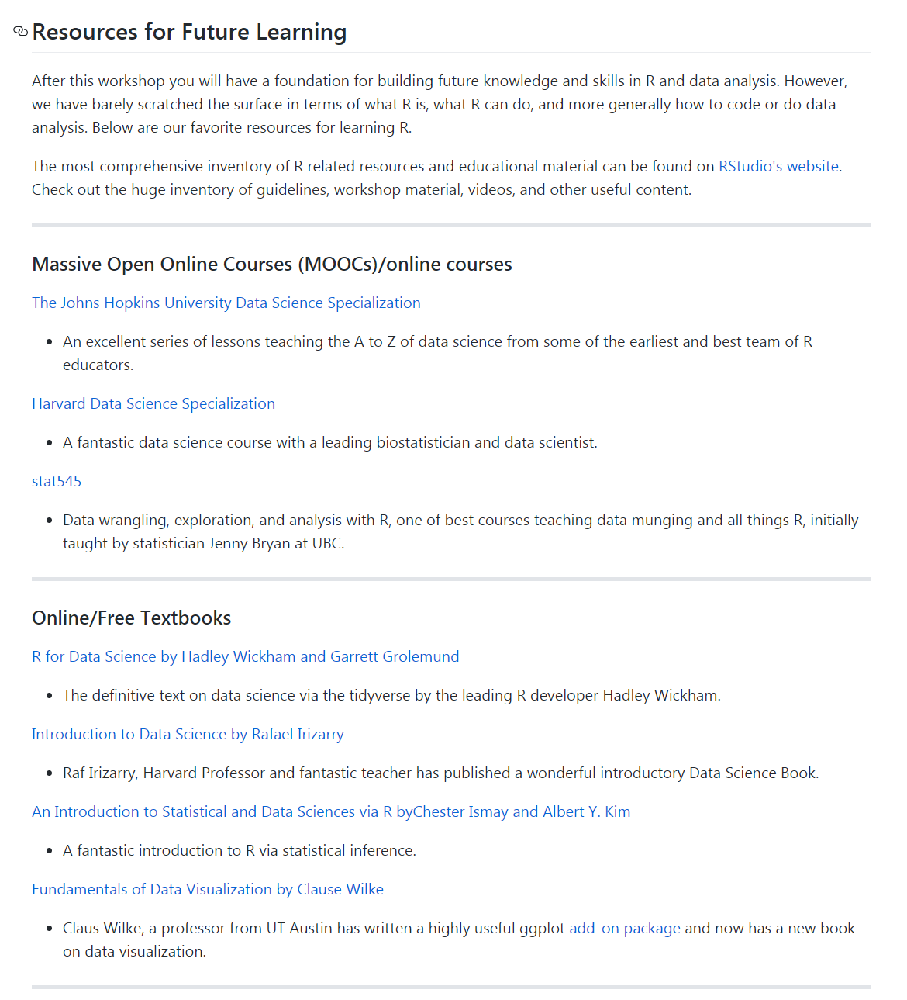
Course Materials
Course Textbook
Slides with course notes
Cheatsheets
Resources

Slide 5
July 16 2020 | Session | Instructor
1:00 pm - 1:30 pm | Instructor Introductions, Introduction to technology | Amrom Obstfeld
1:30 pm - 2:15 pm | Introduction to R and RStudio | Joe Rudolf
2:30 pm - 3:15 pm | R basics for Reproducible Reporting | Patrick Mathias
3:30 pm - 5:00 pm | Data Visualization in R | Stephan Kadauke
July 17 2020
1:00 pm - 2:30 pm | Data Transformation | Amrom Obstfeld
2:45 pm - 4:15 pm | Statistical Analysis in R | Dan Herman
4:30 pm - 5:00 pm | Advanced Reporting in R | Patrick Mathias

Slide 6
Who are we?

Slide 7
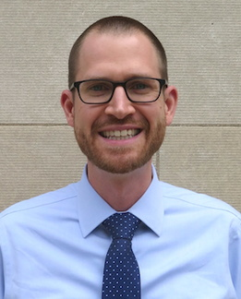
Joseph Rudolf
Assistant Professor, Department of Pathology, University of Utah Medical School
Medical Director, Automated Core Laboratory, ARUP Laboratories
Notes:
Joseph Rudolf, MD is the medical director for the automated core laboratory at ARUP Laboratories in Salt Lake City, Utah. He earned his medical degree (2012) from the University of Washington School of Medicine in Seattle, Washington. He completed his residency training in Clinical Pathology (2015) and fellowship in Clinical Informatics (2017) at the Massachusetts General Hospital in Boston, Massachusetts. His clinical and research interests focus on the intersection of informatics and clinical operations including clinical decision support, utilization management, and reporting and analytics. He is also passionate about clinical process improvement and initiatives to support quality and safety.

Slide 8
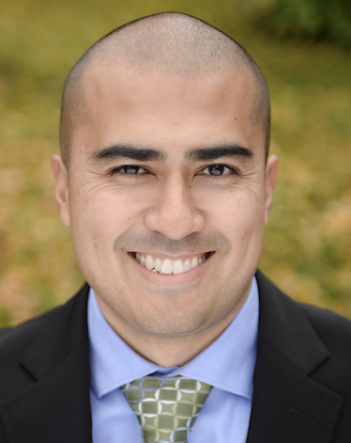
Patrick Mathias
Assistant Professor, Department of Laboratory Medicine
University of Washington School of Medicine
Associate Medical Director, Laboratory Medicine Informatics
Notes:
Patrick Mathias, MD, PhD, is the Associate Medical Director of the Informatics Division in the Department of Laboratory Medicine at the University of Washington School of Medicine. He completed his MD and PhD in Bioengineering at the University of Illinois in Urbana-Champaign, followed by a clinical pathology residency and a clinical informatics fellowship at the University of Washington School of Medicine. His interests include developing data science and analytics as a core competency to improve clinical lab operations and laboratory stewardship, and applying clinical informatics approaches to mitigate laboratory-associated diagnostic errors. He is interested in developing and improving programming and data science education across all levels of pathology practice.

Slide 9
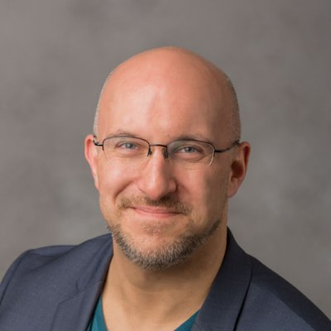
Stephan Kadauke
Assistant Professor of Clinical Pathology and Laboratory Medicine
University of Pennsylvania Perelman School of Medicine
Assistant Director of the Cell and Gene Therapy Laboratory
Children's Hospital of Philadelphia
Notes:
Bio:
After completing high school in Germany, Stephan crossed the Atlantic to study in New York City. From there, he went on to complete Penn's Medical Scientist Training Program (MSTP). In his Pathology residency, Stephan was shocked by the lack of informatics education. So he developed a course in data science specifically tailored for physicians and other health care professionals who deal with clinical data, and he's teaching this course at the Perelman School of Medicine at the University of Pennsylvania.
Stephan works at CHOP where he serves as the Assistant Director of the Cell and Gene Therapy Lab. He is also a part of the new Division of Pathology Informatics where he is promoting physician informatics education.

Slide 10
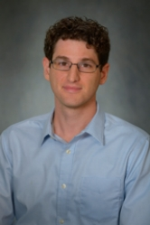
Daniel Herman
Assistant Professor of Pathology and Laboratory Medicine
University of Pennsylvania Perelman School of Medicine
Director, Endocrinology Laboratory
Hospital of the University of Pennsylvania
Notes:
Daniel S. Herman
Assistant Professor of Pathology and Laboratory Medicine, University of Pennsylvania; Director of Endocrinology, Hospital of the University of Pennsylvania
PHILADELPHIA, PA | daniel.herman2@pennmedicine.upenn.edu
Daniel Herman practices clinical pathology at the University of Pennsylvania, where he directs the Endocrinology laboratory at the Hospital of the University of Pennsylvania. He completed his MD and PhD degrees at Harvard Medical School and trained in Clinical Pathology at the University of Washington. His current clinical practice, in addition to clinical chemistry, includes leading informatics projects to make better use of existing laboratory data in the form of live operational dashboards, test utilization reports, and identification of missing patient diagnoses. His research group has been developing EHR-based methods to improve population health screening, focused recently on improving population hypertension management by identifying patients with undiagnosed primary aldosteronism. He is also interested in the intersection of pathology and policy and currently serves as College of American Pathology State Issue Advisor for Pennsylvania.

Slide 11
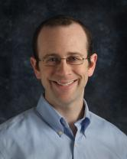
Amrom Obstfeld
Assistant Professor of Clinical Pathology and Laboratory Medicine
University of Pennsylvania Perelman School of Medicine
Director of Pathology Informatics
Children's Hospital of Philadelphia
Notes:
Amrom Obstfeld MD, PhD, is the Medical Director of the Division of Pathology Informatics as well as the Hematology Laboratory at Children’s Hospital of Philadelphia. After receiving his MD and PhD degrees from the College of Physicians and Surgeons at Columbia University, he went on to train in Clinical Pathology at the Hospital of the University of Pennsylvania. In addition to his duties within the Hematology Laboratory, Dr. Obstfeld’s clinical responsibilities include leading the development of analytic tools to aid in laboratory quality management, administration, and operation, and interfacing with other groups throughout the hospital on informatics initiatives.. His research focuses on utilizing clinical and pre-clinical laboratory data sets for predicting diagnosis and prognosis using statistical and machine learning techniques. Dr. Obstfeld plays a major role in designing and implementing educational experiences for pathology trainees and faculty at the University of Pennsylvania within the areas of clinical and pathology informatics.

Slide 12
Workshop Workflow

Slide 13
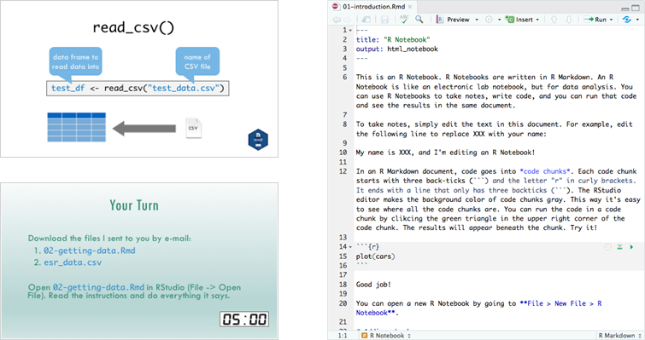
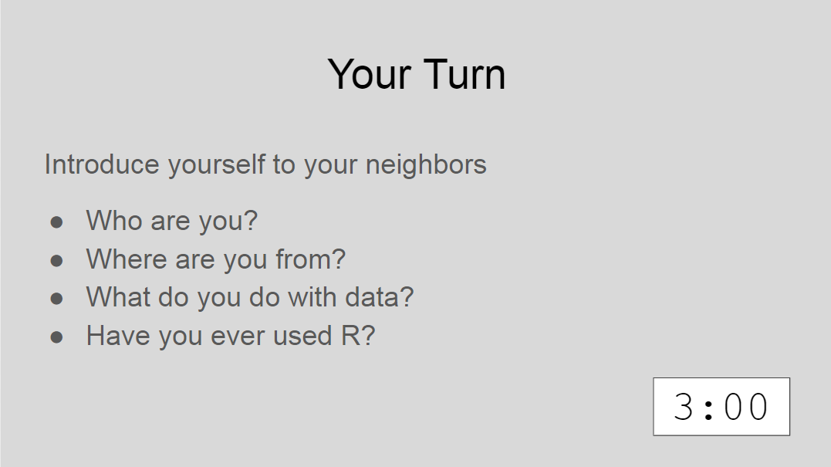
Lectures

Slide 14

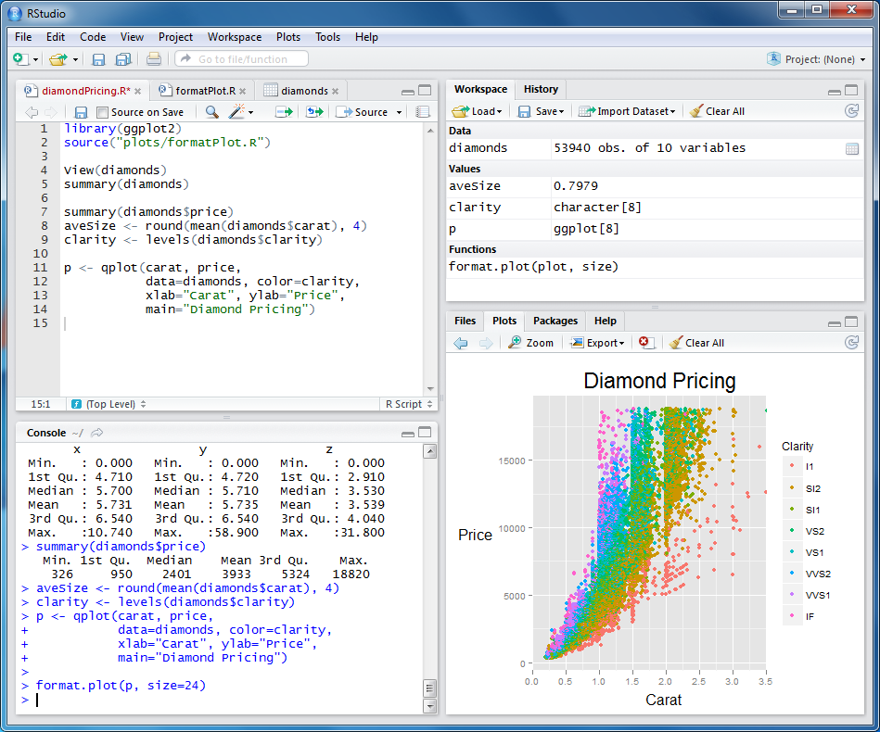
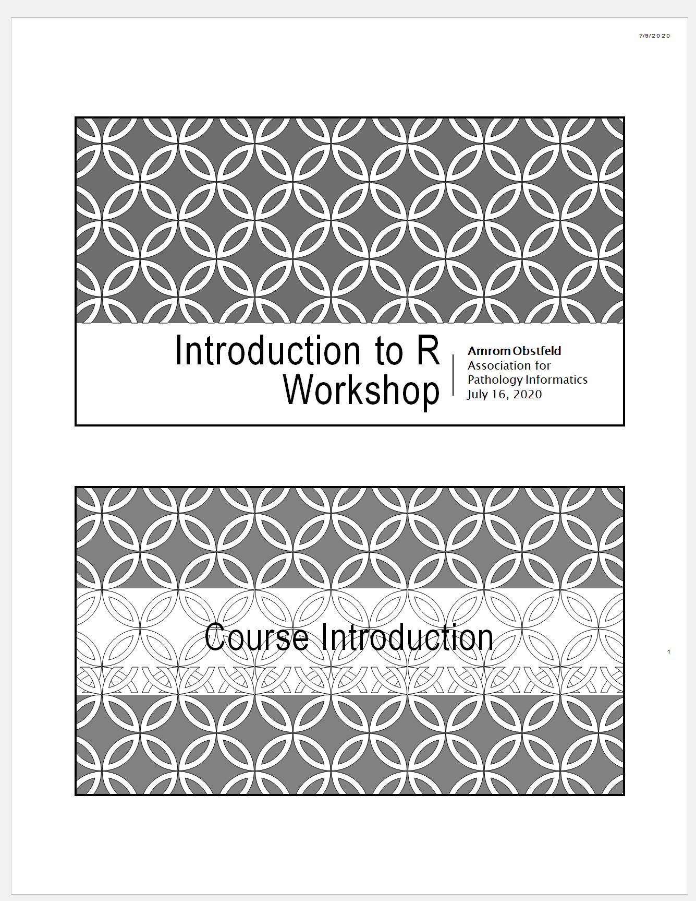
Your Setup

Slide 15
Using Zoom in the workshop
1. All participants will be muted during the main presentations
2. Chat window is always available if help is needed
3. Feel free to use non-verbal feedback to tell us how things are going
4. If you have a question, raise your hand and a TA will direct message you to get you help
5. We'll be trialing break out sessions to allow for more direct interaction and assistance
6. We'll occasionally be using polls to see where people are

Slide 16
Let's try out some Zoom features!

Slide 17
Who are you?

Slide 18
Final Tips
The best way to learn to code is by doing: Find a project, make a goal, and push yourself to use R!
Practice is key!
Moderndive.com

